Slide 1





2017 NSBE Hackathon – gNET+
Hanan Ibrahim
Ruby Kassala
Ja’Lon Sisson
Steve Buza
James Gamble JR

Slide 2
School
City
Major
Email
Extension
Storage Database
Request
Store
Filter
Student
Recruiter
Chat
Google+

Slide 3
Front End

Slide 4
Back End

Slide 5
Web-App API

Slide 6
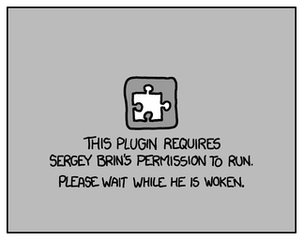
Challenges

Slide 7
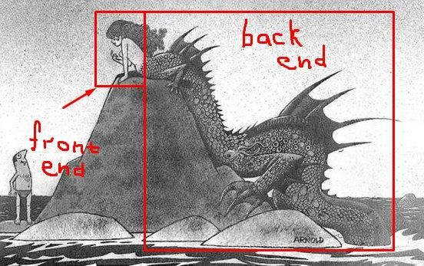
Challenges

Slide 8
Other Applications

Slide 9
Tools Used
Languages:
C++
PostgresSQL
JavaScript
HTML
PHP
Other:
Google Plus API
Google Chrome Extensions
GitHub

Slide 10
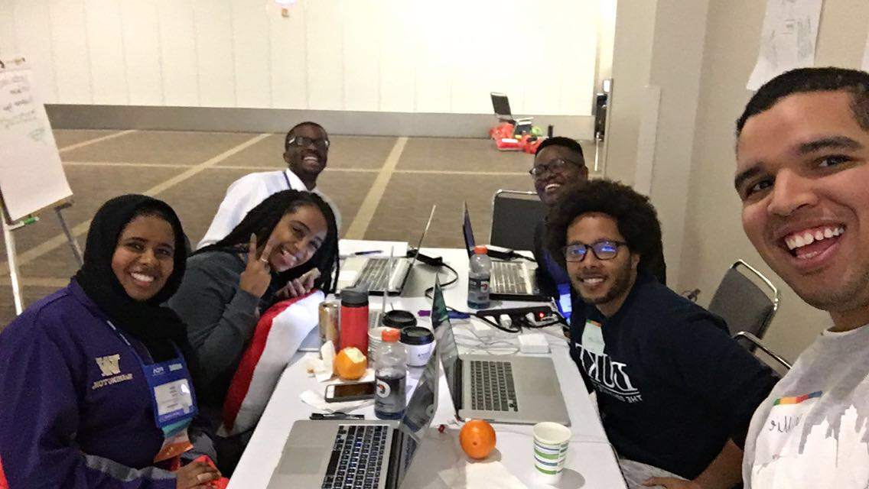

Slide 11

Thank you.
NET+

